Slide 1
Analog Electronics Lab Experiment-5
Instructors name:
P3:
Ashish Kumar Varma
Sambhavi Shukla
P4:
Ankita Dixit
Premsai Regalla

Slide 2
Instrumentation Amplifier

Slide 3
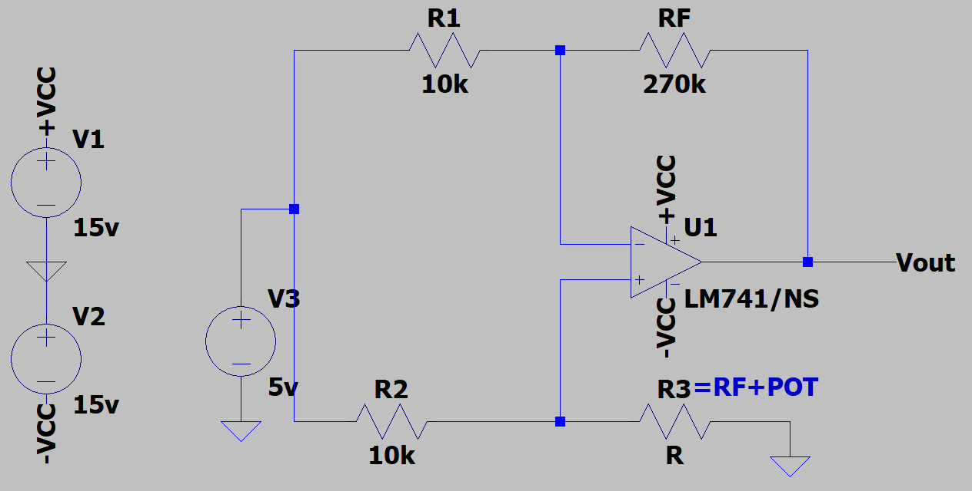
Circuit (A) Set DC null point

Slide 4
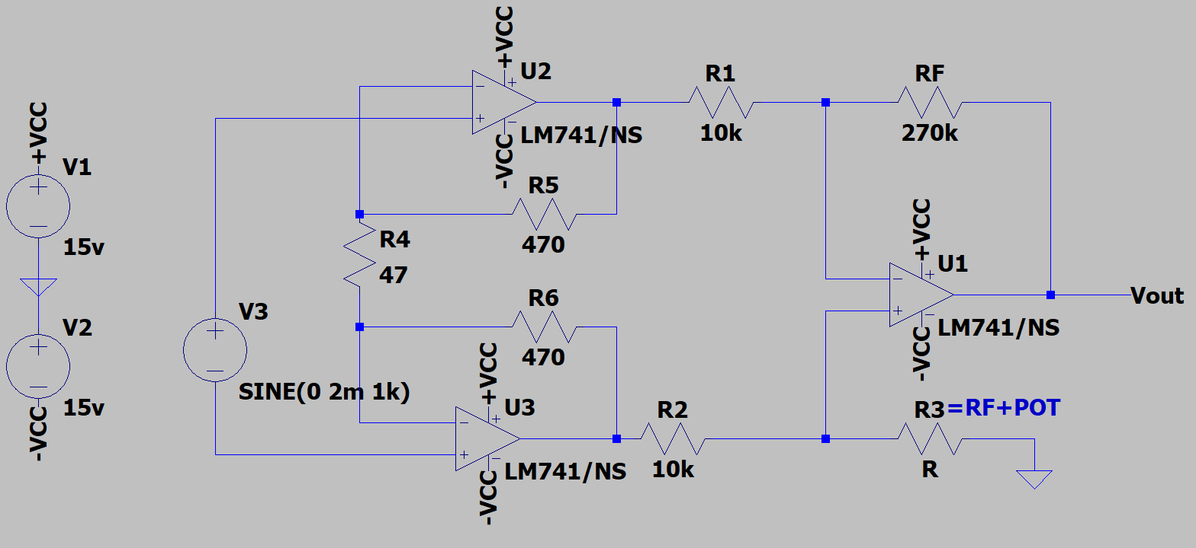
Circuit (B) Common Mode Gain

Slide 5
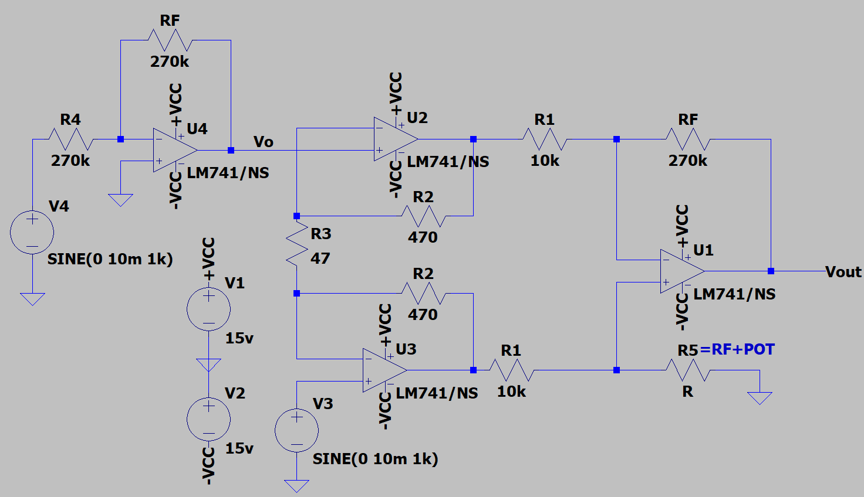
Circuit (C) Differential Mode Gain

Slide 6
Assignment-5:
To study the Instrumentational amplifiers using OP-AMP (IC-741)
Upload a single PDF file on Nalanda which includes
Circuit diagrams for
DC Null point
Common Mode Gain
Differential Mode Gain
2) Calculate CMRR in dB and compare simulated value with theoretical value
Submit the report in a single PDF format (file name should be your ID) on Nalanda within 48 hrs., after your lab section. ( 2 marks deduction for late submission ) Personal submission on email will not be considered.

